Slide 1
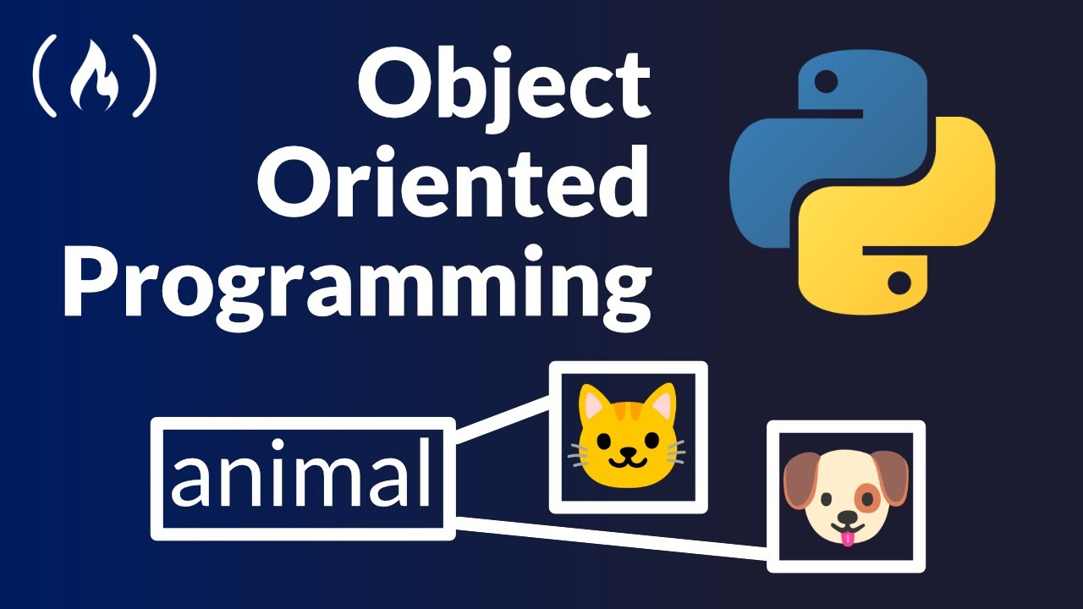
Python! Day 11
Introduction to Object Oriented Programming
Introduction to turtle

Slide 2

What is Object Oriented Programming (OOP)?
If you look at our coffee machine project, the code begins to get a bit complicated because so many things are happening in the machine
If we were to code something like a self-driving car instead of a coffee machine, our code would become very confusing because a self-driving car is very complicated
We could code a self-driving car more easily if we break it up into small parts – like one program for the obstacle-sensing camera, one for the steering wheel, and one for the GPS mapping device
This is called Object Oriented Programming.
It’s different from Procedural Programming, where we write everything at once in chronological order like we’ve been doing so far

Slide 3

Why is object-oriented programming (OOP) useful?
For another example, let's say programming a virtual restaurant.
If we only have one person to do all the jobs in the restaurant (cooking, cleaning, and taking orders), it would be very difficult to run the restaurant
This is like using procedural programming – all the code for running the restaurant is in one complicated and confusing program
Instead, we can hire more than one person to run the restaurant
We can hire a chef for the cooking, a cleaner for the cleaning, and a waiter to take orders. Then, instead of running a restaurant all by ourselves, we just need to manage the chef, cleaner, and waiter.
This is like using object-oriented programming – the employees are all different programs or objects, and the main.py script is the manager

Slide 4

Objects in OOP
The Objects in OOP are sub-parts of the main program
Like the waiter in the restaurant is a sub-part of the restaurant
Programs are like blueprints to create objects
For example, a waiter program would be a blueprint telling the main.py program how to create a waiter object
Objects are defined by 2 things: What they have and what they do
What they have is known as variables of the object or attributes
What they do is known as functions of the object or methods

Slide 5

Creating an Object
Let’s try creating an object in Python
To do this, we’ll start by opening up a new project called Animals
Then, after creating our main.py script, let’s create another script called CatProgram
In our CatProgram file, we should write:
class Cat():
# cat stuff
Next, we can create a cat object in our main.py file by writing:
import CatProgram
simba = CatProgram.Cat()

Slide 6

Now the variable simba holds our Cat object
We can also create a Cat object in the main.py file like this:
from CatProgram import Cat
simba = Cat()

Slide 7
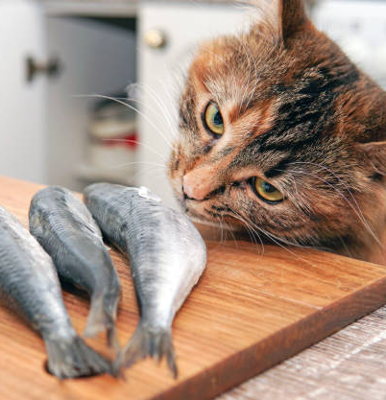
Attributes / What Objects Have
Attributes represent the variables of an object
These are possible attributes for the waiter object of the restaurant
is_holding_plate = True
assigned_tables = [2, 4, 5]
These are essentially just the variables specific to an object
Let’s create some attributes for our Cat object
Note that whatever we write must be indented
has_fish = False
fur_color = “orange”
We can access these attributes in our main.py script by writing:
print(simba.has_fish)

Slide 8

Methods / What Objects Do
Methods represent the functions of an object
The waiter might have a function called get_order that looks like this:
def get_order(self):
order = input(“What is your order? “)
return order
Note that we must write “self” as an input for the function to work

Slide 9
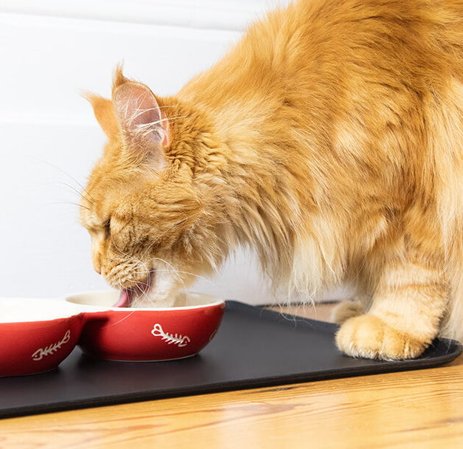
Let’s write some methods for our Cat
def get_fish(self):
self.has_fish = True
def eat_fish(self):
if self.has_fish:
self.has_fish = False
print(“nom nom”)
Notice that we needed to write “self” in front of each of our variables inside the functions. This is because otherwise, Python won’t know that “has_fish” refers to the variable outside the function
We’ll talk about this scope problem more in the future

Slide 10
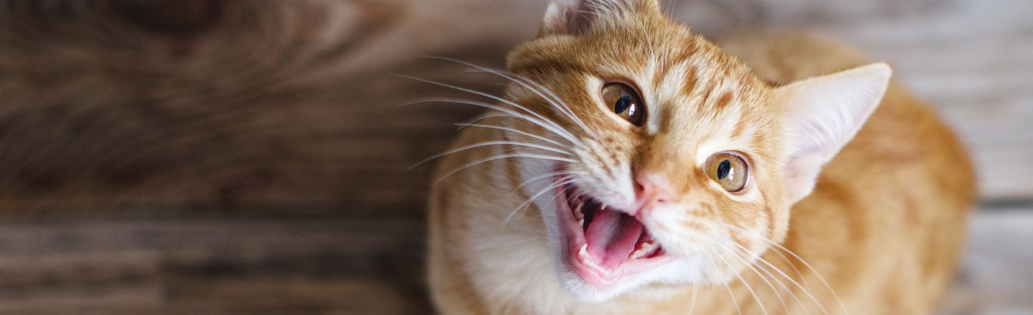
We can now call these methods inside our main.py script like this:
simba.get_fish()
simba.eat_fish()
Now, we can further develop our cat program by writing code that track’s the cat’s happiness, which increases every time the cat eats a fish
We can also create another method to let the cat meow

Slide 11
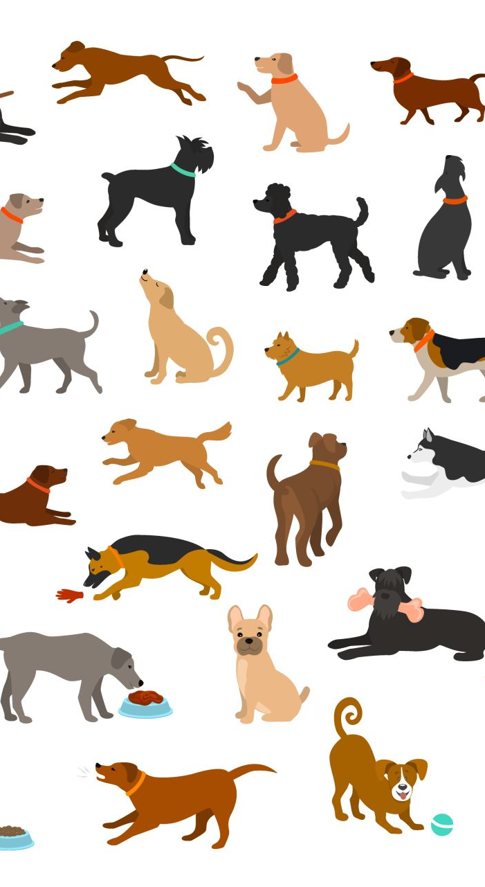
Project: Creating a Dog
Now that we’ve created a blueprint for a cat, let’s create a dog, too
We’ll start by opening up another Python file and we’ll call this one DogProgram
The dog should be able to bark and it should have a happiness level that increases when the dog plays fetch

Slide 12
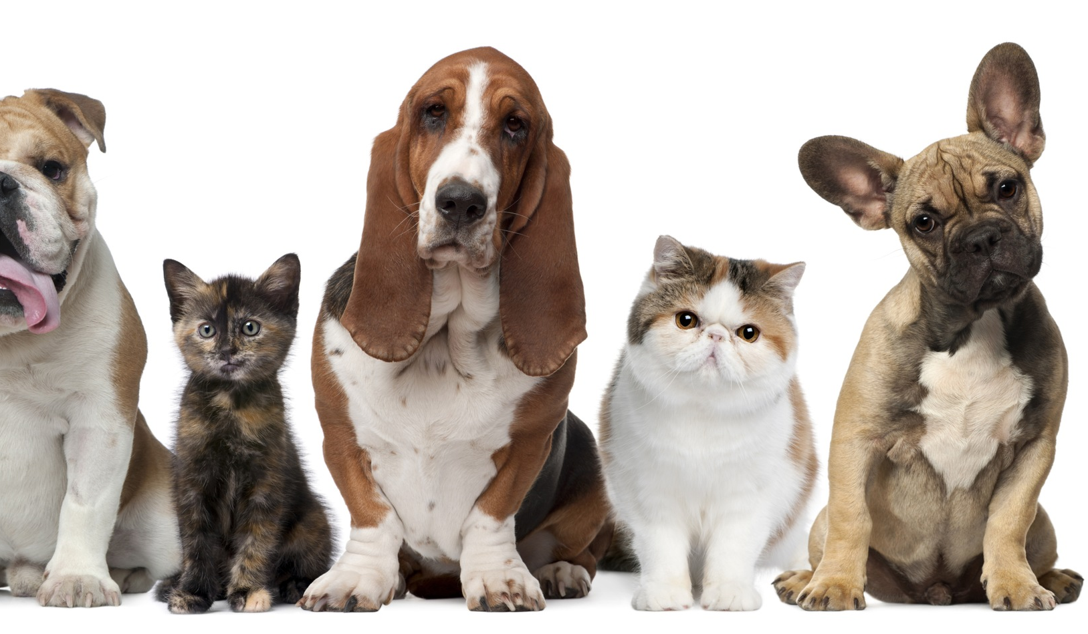
Object Oriented Programming Uses
When we have 2 objects in the same program, it’s easier to see how OOP is useful
If we wrote this animal project procedurally, we would have to create the cat attributes, the cat methods, the dog attributes, the dog methods, and the code of what the cat and dog do all in the same file
This would be really confusing
Using OOP, we can also create multiple versions of the same object:
For example, we can create a second cat named Nala like this
nala = Cat()

Slide 13
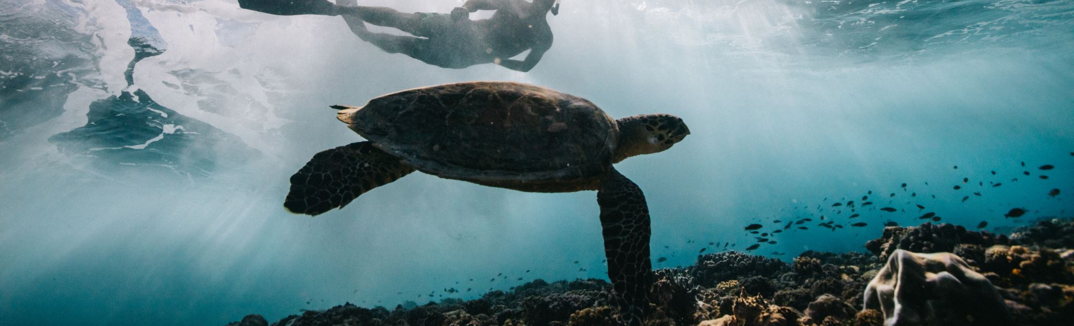
Introduction to Turtle
Now that we’ve created some of our own objects, let’s use some objects built into Python
Mainly, what we’ll be using is the turtle object
To start with, we’ll need to import the turtle class and create a turtle
Like this:
from turtle import Turtle
timmy = Turtle()

Slide 14
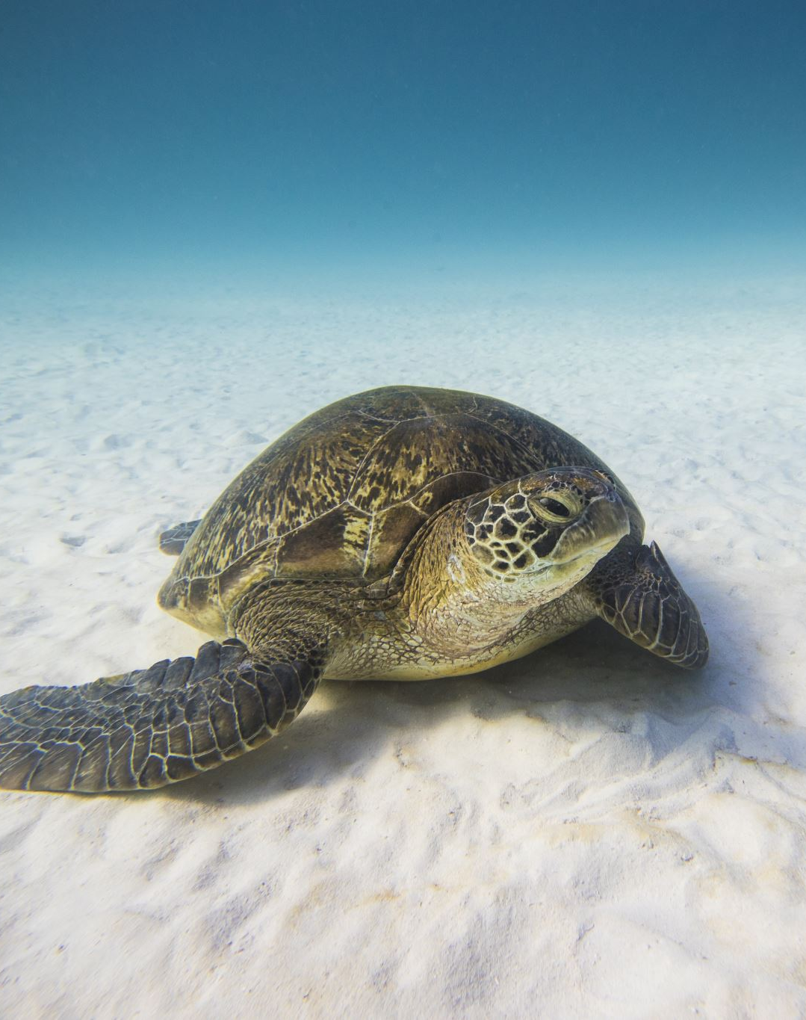
Using the Screen
You’ll notice that when you press play on your turtle program, a panel flashes onto the screen for a second
This is the screen which the turtle will appear on
To use the screen, we’ll need to import it just like we did with the Turtle
We can do that like this:
from turtle import Turtle, Screen
timmy = Turtle()
turtle_screen = Screen()

Slide 15
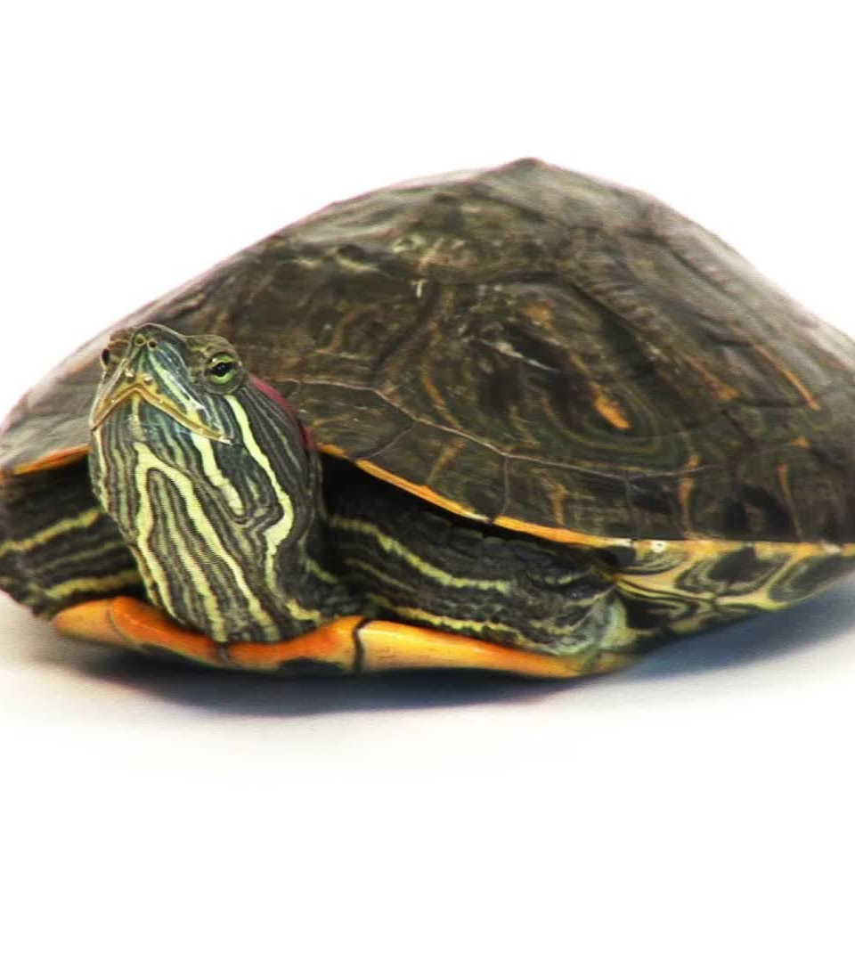
Using the Screen’s Attributes and Methods
We can access the screen’s attributes by writing:
print(turtle_screen.canvheight)
This gives us the height of the screen
This is useful if we want to make the screen bigger or smaller, but for now, 300 is tall enough
We can make the screen not immediately disappear by writing this:
turtle_screen.exitonclick()
This method makes sure that the screen only disappears when the user clicks it

Slide 16

Using the Turtle’s Attributes and Methods
Now that we can see the turtle, we can code it.
Right now, the turtle is an arrow, lets change that so the turtle looks like a turtle
We can do that by writing:
timmy.shape(“turtle”)
We can also change the shape to a circle, square, or triangle
We can change the turtle’s color by writing:
timmy.color(“aqua”)

Slide 17

Finding the Turtle’s Methods
While some methods are easy to remember, it’s impossible to remember all of every object’s attributes and methods.
In this case, we can find more methods by searching “Python turtle documentation.”
Using the information on the turtle documentation page, let’s make the turtle draw a 100 units wide square

Slide 18

Project: Draw the Windows Logo
Let’s use this square drawing to draw the windows logo
We’ll need these methods:
turtle.forward()
turtle. right()
turtle.left()
turtle.up()
turtle.down()
turtle.hideturtle()

